Slide 1
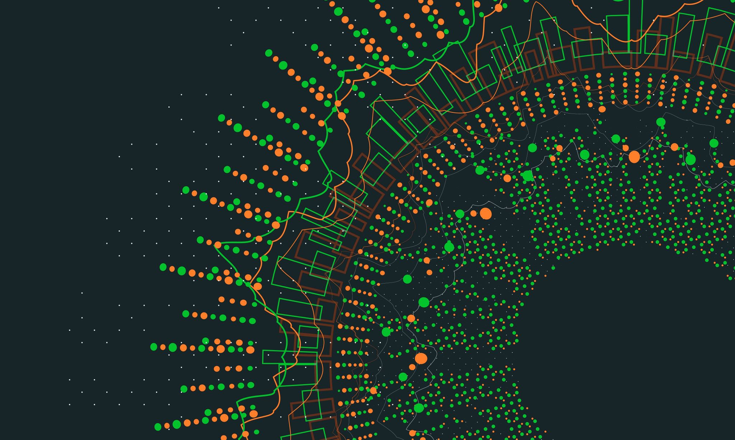
Group 26 Final Project Proposal
Recognizing bird species
By: Julia Bozzino, Ganesh Gopalkrishna Hegde, and Robin Kneepkens

Slide 2
Task and motivation
Task statement: make a neural network that that classify bird species from pictures.
Object localization (bounding box around bird in picture)
Bird classification (from the cropped image)
Motivation:
Fine-grained image classification seems to be getting more popular.
One of our group members really likes birds.
It seems like an interesting challenge.
Related work:
Deep learning leaderboard for this specific dataset. (many papers)
Older research using more classical machine learning for recognizing birds in flight.
Spatial Pyramid Pooling for handling arbitrary sized input images.

Slide 3
Goals
Expected achievements:
Multi-network architecture: one for finding bird in image and cropping (BirdSpotter), other for classifying said bird (Birder).
Both CNN’s have an SPP layer to handle any input sized image.
Compare our results with aforementioned leaderboard.
Be able to handle a wide variety of input sizes by implementing SPP.
SPP can be used on CNN’s to have a fixed size output regardless of input size.
Midterm plans:
Have a robust way to load and interact with the dataset.
Finish exploratory data analysis of the dataset.
Implement BirdSpotter network.

Slide 4
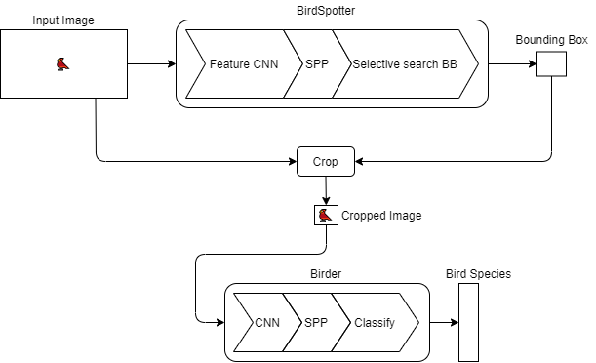
Methods
Architecture
Our architecture will look consist of two CNN’s.
BirdSpotter will spot the bird in the image and provide a bounding box to crop.
Birder will identify the bird from the cropped image.
Both networks will use the spatial pyramid pooling layers so they can handle various input image sizes.
We can use pretrained convolution layers for feature extraction and then change out the last few layers for the bounding box and classification. We can start with VGG, because we have some experience with that already. If there is time left, we can experiment with other networks for feature extraction.
It may be interesting to try and train a specific feature extractor for the birder network, as it might be able to learn some patterns specific to birds, but this is an optional extra feature we may implement.
For SPP, we’ll follow the paper and use a four-level pyramid with resolutions (1x1, 2x2, 3x3, 6x6). This can also be experimented with later.
Sources:
SPP for classification and bounding, original paper.
PyTorch SPP implementation details, forum post.
Code for Selective Search Object Proposal, github.
PyTorch Pretrained CNN’s, PyTorch website.
Related Work:
Radiology diagnoses using similar cropping technique, original paper. Has similar architecture as us.

Slide 5
Data
NABirds Dataset from the Cornell Lab of Ornithology.
48000 annotated photographs. Annotations include bounding boxes and species names, which we will need.
400 species of birds from North America.
Images are of wildly varying sizes, hence the BirdSpotter network to deal with that. This allows us to not crop/resize/pad the images, which hopefully leads to better classification.

Slide 6
Evaluation
Main metric will be classification accuracy of the Birder network.
We can compare our results on the PapersWithCode Leaderboard for this dataset.
We will also need to take the accuracy of the BirdSpotter Network into account. A proper loss metric for that seems to be the one mentioned here. There is also the Pascal overlap criterion mentioned in this paper. Mean Average Precision seems like a good metric to evaluate BirdSpotter with.

Slide 7
References
Guides/Tutorials for implementing:
Mean Average Precision
Overview on object detection (bounding boxes)
Implementing SPP with PyTorch
Source Papers
Spatial Pyramid Pooling
Selective Search for Object Proposals
Related Work
Similar hard attention based approach for radiology diagnosis
Current number 1 on the leaderboard
Other References
Leaderboard

